Slide 1

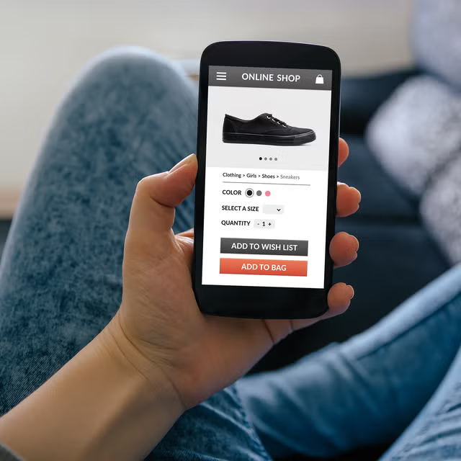
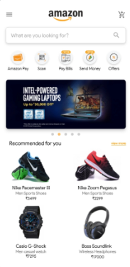
EcoTrack
Sustainable Pathways: Efficiency Meets
Eco-Friendly Solutions

Slide 2

Team SCOE
Samarth Shendre (Leader)
Atharv Suravse
Saee Bandal
Sanidhya Naik

Slide 3
Theme Benefits
EcoTrack: Innovating for a Greener Tomorrow" combines advanced technology with sustainable practices to reduce environmental impact. By optimizing delivery routes, reusing packaging, and offering virtual try-ons, the platform promotes fuel savings, waste reduction, and energy-efficient operations. This solution redefines e-commerce with eco-friendly features for a more sustainable, greener future.
1 .
2 .
3 .
4 .
FUEL & COST SAVINGS:
WASTE REDUCTION:
PAPERLESS & EFFICIENT:
LOWER RETURNS & EMISSIONS:FICIENT:
Optimized routes and reusable packaging reduce fuel consumption and operational costs.
Encourages packaging reuse, cutting down on waste and promoting sustainability.
Digital product details and language translation minimize paper usage and improve accessibility.
Virtual try-ons help customers make informed decisions, reducing product returns and transportation energy.

Slide 4
Solution Overview
Package Details & Location
Tracking
Smart Route Optimization
Virtual Product Visualization
A scanner for capturing package and location details. Real time updates for both user and delivery partners.
Shortest path calculation for faster deliveries . Reduces fuel consumption , overall reduces delivery costs.
Virtual try-on technology for clothes, watches, shoes etc. Users can try on products digitally before purchase.
Reduces returns, saving on transportation costs and fuels.

Slide 5
Decision Rationale
Accuracy & Efficiency
Enhanced Customer Experience
Sustainable Operations
A scanner for capturing package and location details. Real time updates for both user and delivery partners.
Virtual try-on reduces returns, saving costs and minimizing environmental impact. Accurate tracking improves reliability and trust.
Optimized routing minimizes fuel consumption and carbon footprint. Reduced returns further contribute to sustainable practices.

Slide 6





Technology Stack
Python
Backend development, AI, optimization algorithms.
Flutter
Cross-platform mobile app development for a seamless user experience.
Google Maps
Real-time navigation, shortest path routing, and accurate location tracking.
MongoDB
Helps to store data required for users as well as delivery partners.
Google API Language Translator
Translates the screen into desired/multiple language.

Slide 7

Video Demonstration of EcoTrack

Slide 8
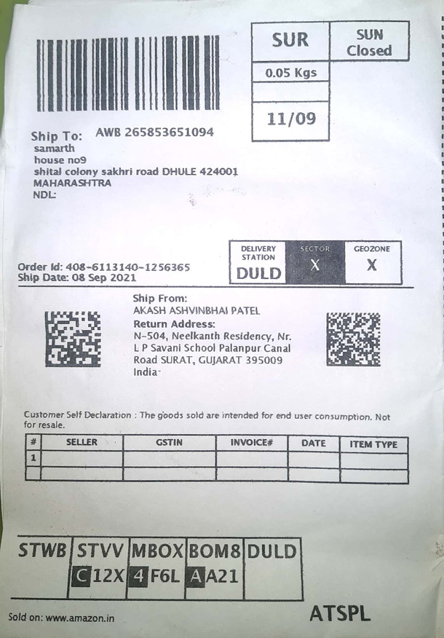

Innovation Highlights
Our Application is mainly targeting to reduce operation cost and conserve natural resources
1)Paperless Logistics with QR Code Integration
Transition from traditional paper invoices to dynamic QR codes that provide real-time access to product information, logistics details, and warranty without paper waste

Slide 9
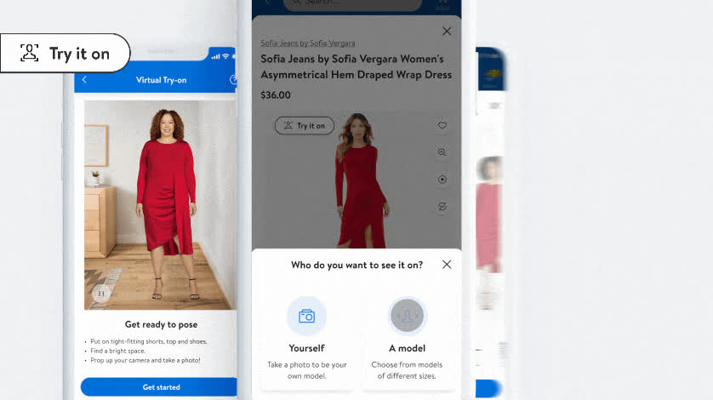
Innovation Highlights
Our Application is mainly targeting to reduce operation cost and conserve natural resources
3)AR-Driven Virtual Try-On Experience
4)Locate Easily by Pinning location
2)Reusable Packaging Return System
A closed-loop packaging system where customers can return packaging materials during their next delivery
It decreases product return rates, and minimizes carbon emissions from reverse logistics due to reduced returns.
Use AI and Machine Learning algorithms to optimize delivery routes, reduce fuel consumption, and minimize carbon emissions.

Slide 10
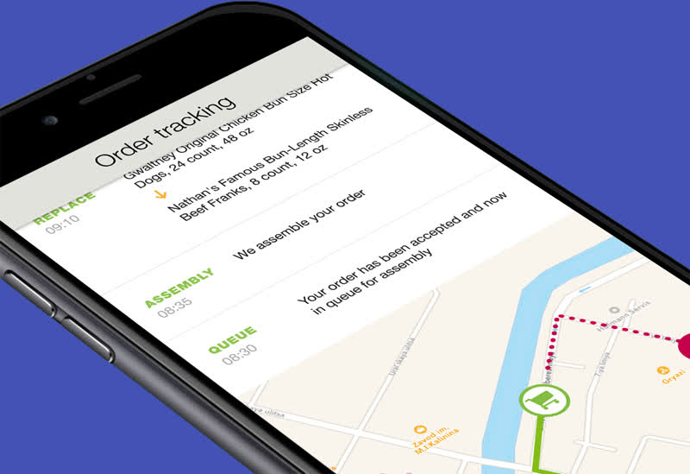
Feasibility
1)QR Code Integration
2AR for Virtual Try On
3)Real Time Tracking
Technical Feasibility
1)Cost Effective Developement
2)Potential Saving with Paperless invoicing, Reusable Packaging
3)High ROI due to cost saving in Operations
Economic Feasibility
1)Scalability - The solution can scale across multiple sectors (e-commerce, fashion, electronics).
2)Additional resources needed for customer support and packaging return logistics.
3)Challenge in Establishing a network for packaging return logistics with partners and suppliers.
Operational Feasibility

Slide 11
User Friendliness
UI - User Interface
UX - User Experience
QR Code Scanning
Progresssive Disclosure
Reusable Packaging Option
Hassle Free QR Code Access
Virtual AI Try On Interface
One-Click Return for Packaging

Slide 12
Success Metrics
Sustainability Metrics
User Engagement & Adoption Metrics
Operational Metrics
1)QR Code Scan Success Rate (%)
2)AR Virtual Try-On Accuracy (%)
3)Packaging Collection Efficiency
4)Average Response Time (Support)
1)Paper Savings (kg/month)
2)Reusable Packaging Return Rate
3)Carbon Emission Reduction (%)
4)Packaging Waste Reduction (%)
1)Feature Usage Rate (%)
2)Customer Satisfaction Score (CSAT)
3)User Retention Rate (%)

Slide 13
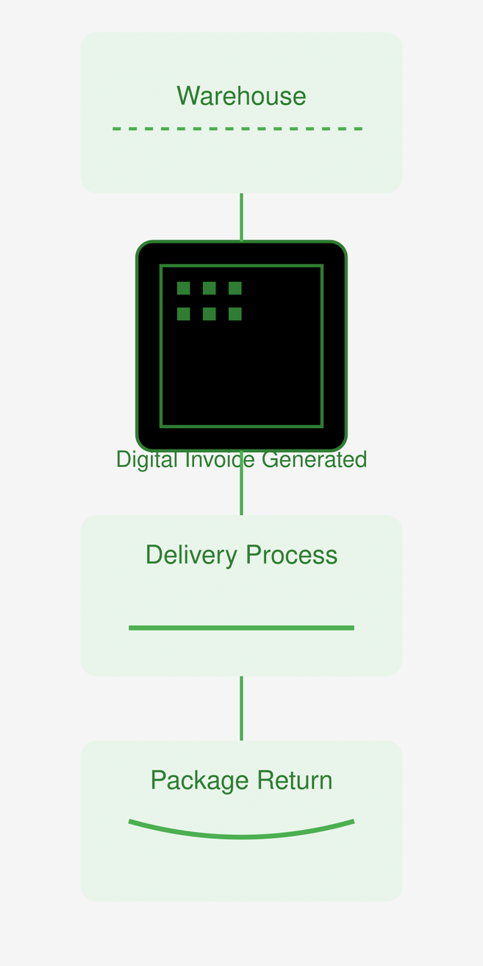
Methodology / Architecture
IIt will suggest how does the System Progresses
How does Eco-Track Works
1) Items would be packaged
2)Instead of Physical Invoice details will be mentioned on Digital Invoice (QR)
3)Items would be delievered to customer and packaging will reuturned in next turn

Slide 14
Team SCOE

